Slide 1
GRAPH2SEQ: GRAPH TO SEQUENCE LEARNING WITH ATTENTION-BASED NEURAL NETWORKS
ICLR 2019 Conference
Kun Xu, Lingfei Wu, Zhiguo Wang, Yansong Feng, Michael Witbrock, Vadim Sheinin
2020-03-26
JuHyoung Kim
kjhkjh75@naver.com

Slide 2
- Why graph to seq?
Seq to seq achieve many tasks such as neural machine translation, natural language generation, speech recognition.
Many enhancements
1) attention mechanisms
2) bidirectional recurrent neural networks
3) bidirectional long short-term memory networks
as encoders have been proposed.
Significant limitation
1) inputs are sequence, simplest structured data
2) problems are expressed with a more complex structure
3) more capacity to encode complicated pairwise relationships

Slide 3
- Why graph to seq?
For limitations of Seq to seq when dealing with more complex data,
Leverage external information using specialized neural models
1) Tree to seq
2) Set to seq
3) Tree structure LSTM
A number of research has investigated to utilize various GNN
Contribution
1) First general-purpose encoder-decoder model for Graph to sequence
2) design their own graph embedding techniques.

Slide 4
- Overall architecture
Conventional encoder-decoder with two main components
graph encoder and sequence decoder.
Graph encoder aims
to learn expressive node embeddings
to reassemble them into the corresponding graph embeddings
Propose an inductive graph-based neural network.
RNN-based decoder
takes the graph embedding as its initial hidden state
outputs a target prediction by learning to align and translate

Slide 5
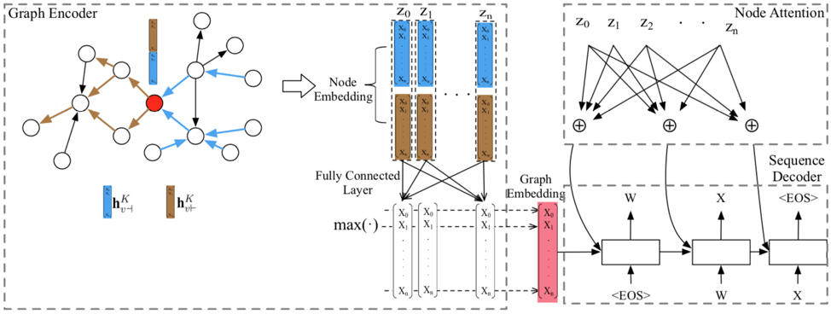
- Overall architecture

Slide 6

Graph to Sequence model
Node embedding generation
1) bi-directional node by aggregating information from a node local forward and backward neighborhood .
Node : v`s
Feature vector : av
Embedding matrix : We
: forward neighbors returns the node that v directs
: backward neighbors returns the node that direct to v
k : iteration index.

Slide 7
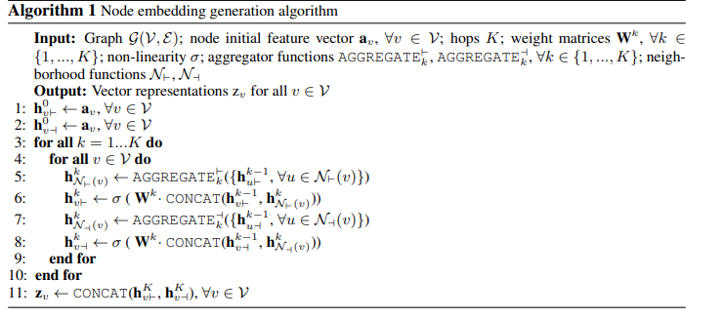
Graph to Sequence model

Slide 8
Graph to Sequence model
Graph Embedding Generation
1) graph embeddings that convey the entire graph information
- Two approaches
Pooling-based and Node-based
Pooling based Graph Embedding : fed the node embeddings to a fully-connected neural networks and applied each pooling element-wise
Max-pooling in this case
Node based Graph Embedding : Add one super node Vs into the input graph
and other nodes in the graph direct to Vs

Slide 9
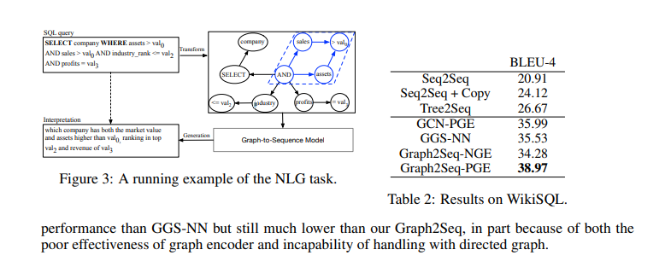
Experiment

Slide 10
Future work.
What information to apply model?
Graph can process dependency?

